Slide 1


Simulation & Characterization of NanoScaled FET
Mid-Review 1
Major Project
Project ID: V1
AY 2021-25
GITAM (Deemed-to-be) University
Department of Electrical Electronics and Communication Engineering
Project Team:
Niharika Sidda (BU21EECE0100374)
Jillela Mounika (BU21EECE0100448)
Sushanth Pasupuleti (BU21EECE0100466)
Project Mentor:
Dr. Ajit Kumar
Project In-charge:
Rohan Prasad
www.gitam.edu

Slide 2
Objective and Goals
Objective
1.Design and simulate IM-FET,DGIM-FET,JL-FET & nDGJL-FET. 2. Compare them with each other. 3. Measuring performance metrics. 4. Studying scaling impact.
Goals
Main Goals :
1. Make a faster and more efficient transistor. 2. Reduce power loss and overheating.
3.Ensure better performance in small sizes.
4. Scalability

Slide 3
Abstract:
The semiconductor devices have been scaled down to nanometer dimension. Henceforth, it has become a great importance to simulate and study their behavior before the fabrication and implementation. Among many of the modern devices are Multi-gate devices, Junctionless devices, and Hetero-junction devices. The device characteristics of these devices are of great importance with respect to application point of view. In our present work, we shall carry out TCAD Sentaurus based simulation of few among these to study and compare their characteristics. Further, we shall also study the variation in the characteristics with device scaling.

Slide 4
Comparison table:
Parameter | IM-FET | DGIM-FET | JL-FET | nDGJL-FET
Size | Moderate | Smaller than IMFET | Very Small | Smallest among all
Speed | Moderate | Fast | Fast but slower than DGIM | Fastest
Thermal Stability | Moderate | Better than IMFET | lower stability | Best
Majority Carriers | Electrons (n-type) / Holes (p-type) | Electrons (n-type) / Holes (p-type) | Electrons (n-type) / Holes (p-type) | Electrons (n-type) / Holes (p-type)
Minority Carriers | Few due to inversion layer | Fewer than IMFET | Not Available(no junction) | Almost negligible

Slide 5
Parameter | IM - FET | DGIM-FET | JL-FET | nDGJL-FET
Leakage Current | High | Low | Low | Very Low
Threshold Voltage (Vth) | Moderate | Lower than IMFET | Lowest among all | Optimal (better than JL but controlled)
ID vs VG Plot | Standard like MOSFET | Steeper than IMFET | Slower rise | Steepest increase
Doping Profile | Normal doping | High doping in channel region | Uniform doping throughout | Ultra-thin uniform doping
Fabrication Complexity | Standard CMOS | More complex due to double-gate | Easier than DGIM but has leakage issues | Most complex but best performance

Slide 6
Parameter | IM-FET | DGIM-FET | JL-FET | nDGJL-FET
power consumption | High | Moderate | Low | Lowest
scalability | Low | Medium | High | Very high
Heat Dissipation | High | Medium | Low | Lowest
Applications | General MOSFET applications | High-speed and low-power applications | Low-power but high-leakage applications | Ultra-low power, high-performance applications

Slide 7
Literature Survey:
Title | Author | Year | Technology Used | Summary | Pro | Limitation
Device and circuit performance analysis of double gate junctionless transistors at Lg = 18 nm | Chitrakant Sahu, Jawar Singh | 2014 | ATLAS TCAD mixed-mode simulator | JL DG devices outperform IM FETs with better speed and stability. | Faster performance and improved SRAM stability | JL design complexity compared to conventional CMOS.
Analysis of Delta-Doped and Uniformly Doped AlGaAs/GaAs HEMTs by Ensemble Monte Carlo Simulations | Ki Wook Kim, Hong Tian, Michael A. Littlejohn | 1991 | Uniformly doped AlGaAs/GaAs high electron mobility transistors (HEMTs) | Delta-doped HEMTs outperform uniform ones in electron density and speed. | Improved transconductance and drain current drive | Increased complexity in device structure and fabrication.

Slide 8
Title | Author | Year | Technology Used | Summary | Pro | Limitation
A Physics-Based Threshold Voltage Model for Junctionless Double Gate FETs Having Vertical Structural and Doping Asymmetry | A. Kumar, J. N. Roy | 2019 | Synopsys Sentaurus Device simulation tool, MATLAB | Model for asymmetric JL DG FETs simplifies analysis while maintaining accuracy | Simplifies complex calculations with improved accuracy. | May not account for all real-world device variations.
Impact of Single Charged Gate Oxide Defects on the Performance and Scaling of Nanoscaled FETs | J. Franco, B. Kaczer, M. Toledano-Luque, et al. | 2012 | Nanoscaled Field-Effect Transistors (FETs) particularly pFinFETs and planar pMOSFETs, which include SiGe channel devices | NBTI reliability in nanoscaled FETs varies by technology, impacting scaling | SiGe channel devices exhibit reduced time-dependent variability, enhancing NBTI robustness. | The severe 1/area scaling rule complicates reliability predictions for further scaling.

Slide 9
TITLE | AUTHOR |  | YEAR | TECHNOLOGY USED | SUMMARY | PRO | LIMITATION
Thermo-magnetic effects on MOSFETs simulated and experimentally characterized for reliability 5th | Gabriela A. Rodríguez-Ruiz et al. |  | 2015 | Thermo-magnetic modeling and simulation in nano-scaled MOSFETs. | The paper introduces a simulation method for studying the effects of temperature and magnetic fields on the gate tunneling current in MOSFET devices. | Provides a new method for mapping electronic properties in nanoscaled MOSFETs. | Simulation and experimental setup are complex and require precise control.

Slide 10
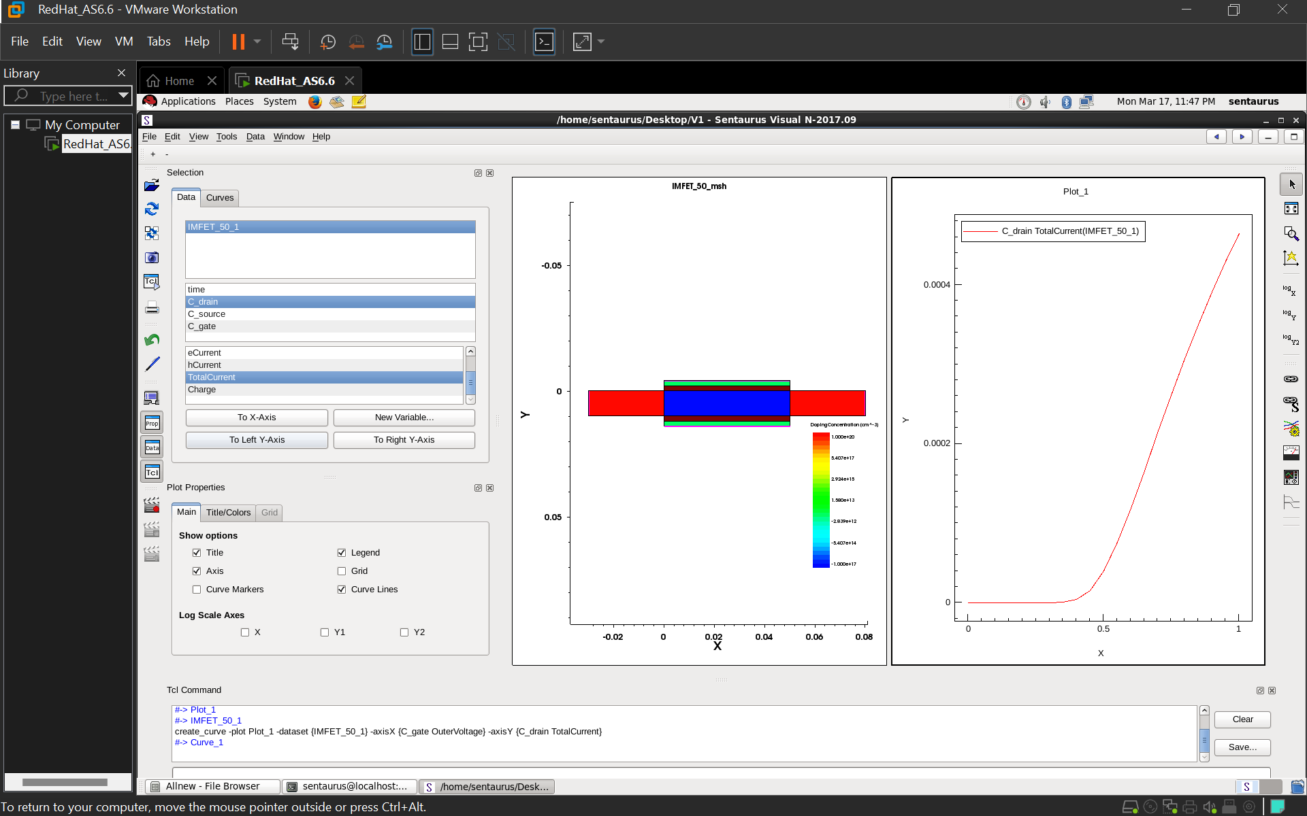
IM-FET :
IMPLEMENTATION:

Slide 11
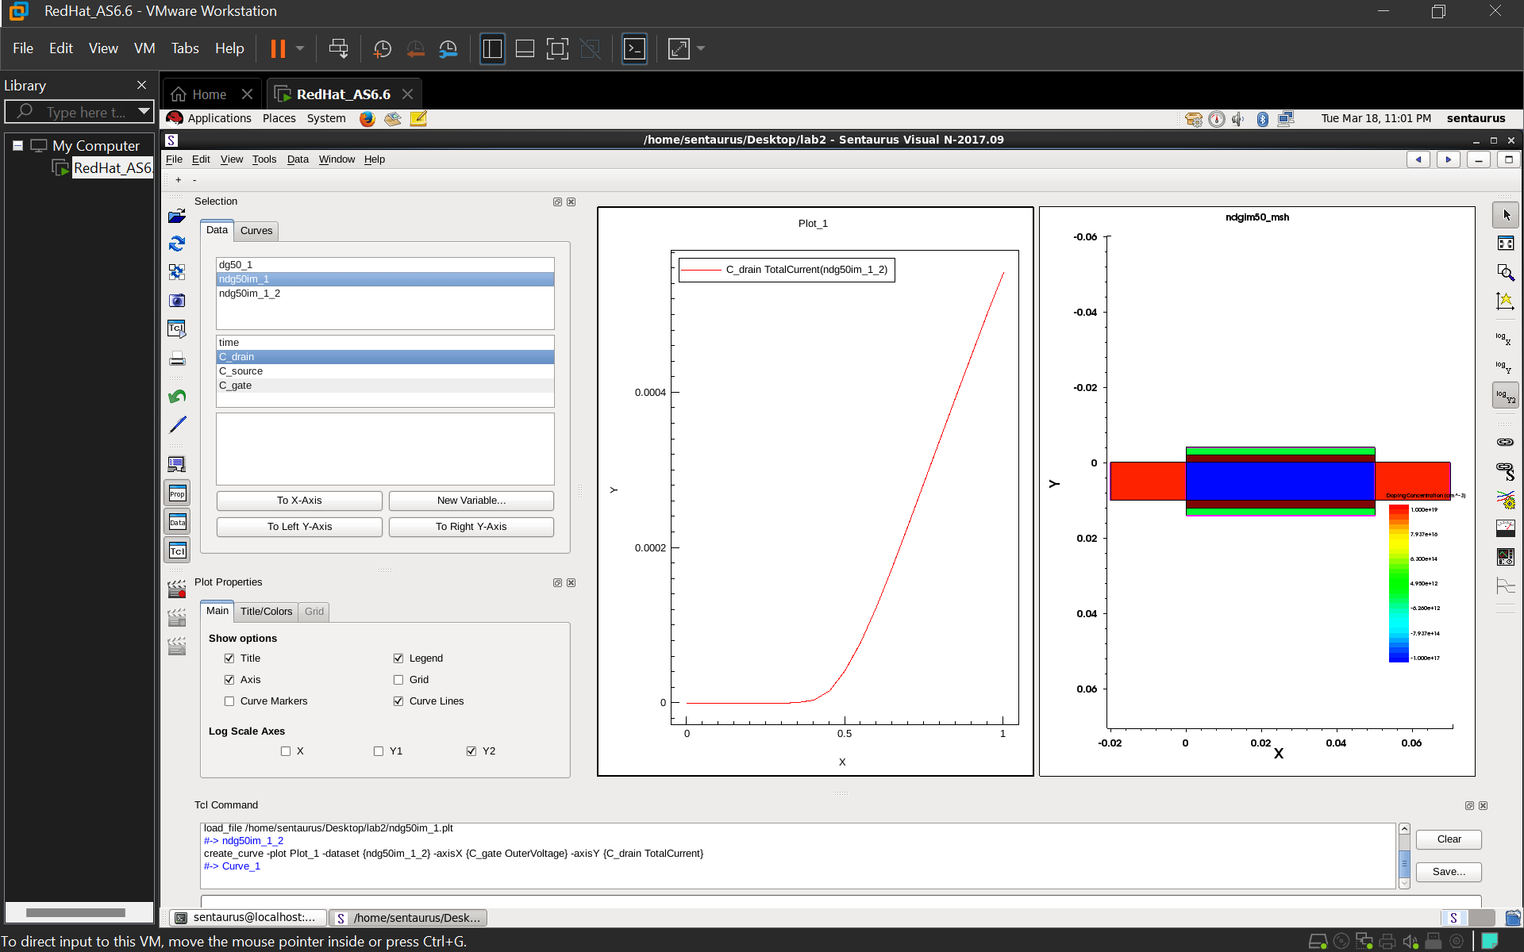
DGIM-FET:

Slide 12
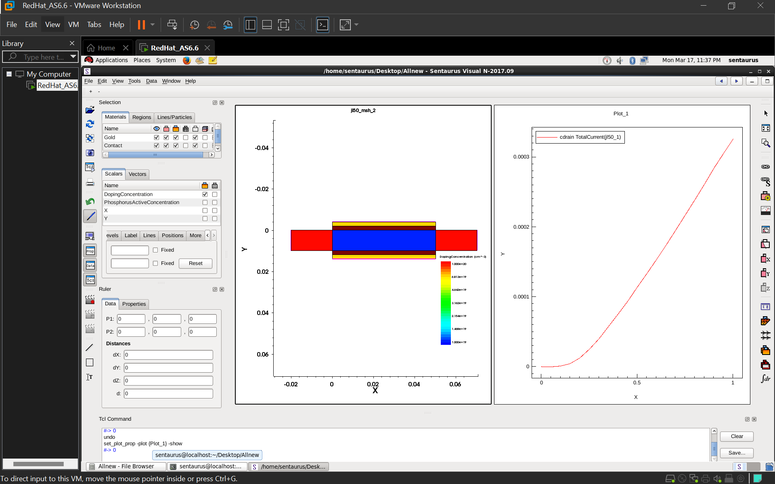
JL-FET:

Slide 13
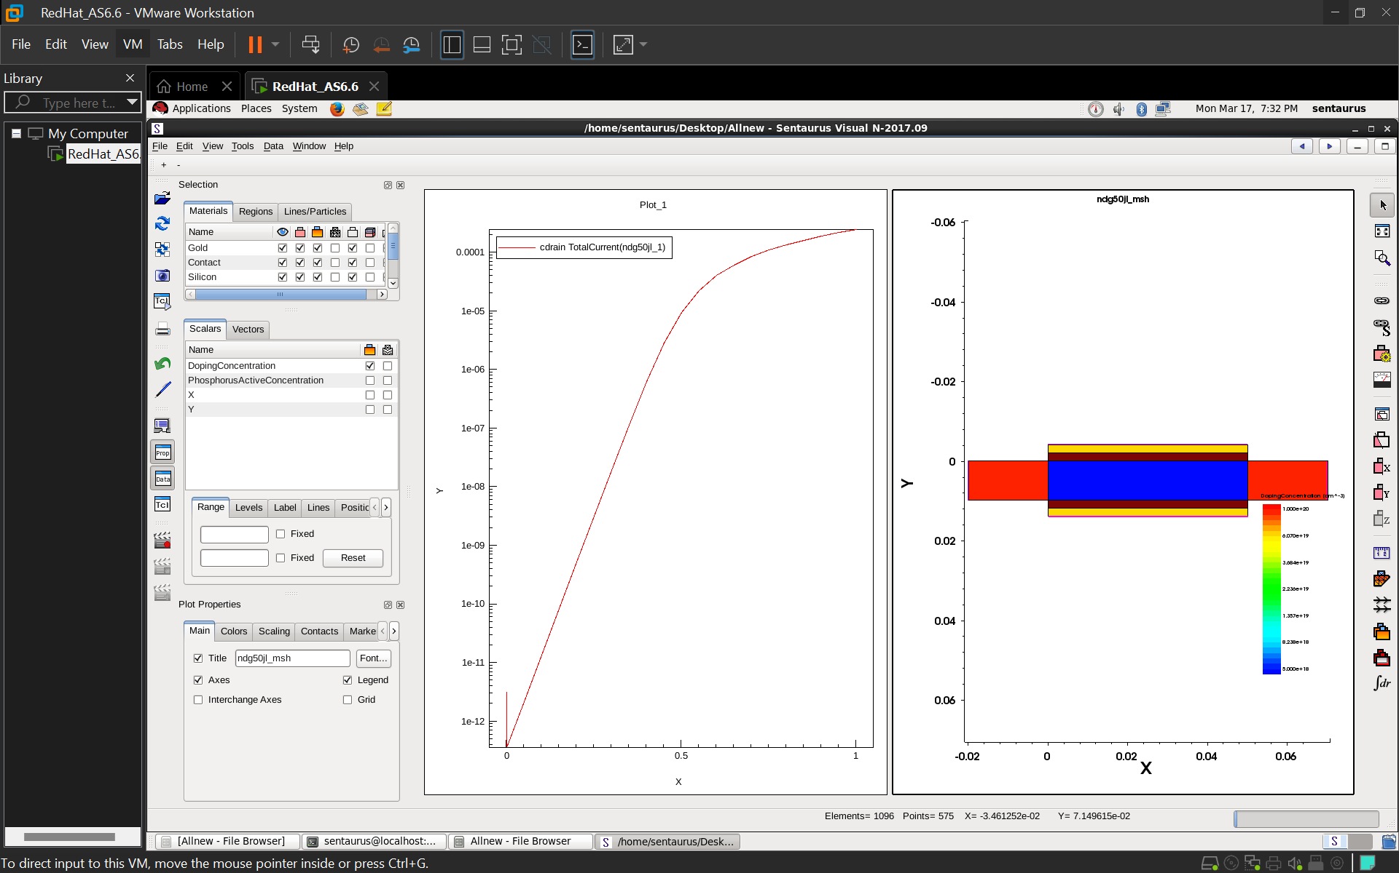
nDGJL-FET:

Slide 14
Results:
Name | IM-FET | DGIM-FET | JL-FET | nDGJL-FET
Threshold Voltage | 0.474346V | 0.472654V | 0.27251V | 0.5539V
Transconductance (Gm) | 0.000950 | 0.00110 | 0.0004529 | 0.00055
Ioff(Id at Vg=0) | 2.49 x 10^ -18 A | 1.75 x 10^ - 19 A | 5.28 x 10 ^ -17 A | 3.17 x 10^-12 A
Id sat | 0.000465 A | 0.000555 A | 0.000326 A | 0.000246 A
R out | 1.839 x 10 ^ 6 | 1.655 x 10 ^ 6 | 2.130 x 10 ^ 6 | 2.054 x 10 ^ 6
R On | 0 | 0 | 0 | 0

Slide 15
Result:
Based on all the given parameters, DGIM-FET is the best choice for our project. Here's why:
Best Performance (GmMax = 0.00110)
Higher GmMax means better amplification and switching speed.
DGIM-FET has the highest value, making it the most efficient.
Lowest Power Consumption (Ioff = 1.75 × 10⁻¹⁹ A)
It has the lowest leakage current, meaning less power is wasted when the device is off.
Highest Drive Strength (Id,sat = 0.000555 A)
It provides the highest saturation current, which means it can handle more load and perform better.
Balanced Output Resistance (Rout = 1.655 × 10⁶ Ω)
Good output resistance ensures stable operation and less power loss.

Slide 16
Conclusion & Future Work
Summary :
In this project, we analyzed and compared four advanced transistor technologies: IM-FET, DGIM-FET, JL-FET, and nDGJL-FET. The comparison was based on key factors like size, speed, power consumption, heat dissipation, leakage current, scalability, and applications. Each technology has its own advantages and drawbacks, making them suitable for different applications.
Our simulations showed that DGIM-FET performs the best in most aspects. It is the smallest, fastest, most power-efficient, and highly scalable, making it ideal for modern, low-power, and high-speed applications.
Conclusion :
We conclude that DGIM-FET is the best choice because it has ;
Best Performance (GmMax = 0.00110)
Lowest Power Consumption (Ioff = 1.75 × 10⁻¹⁹ A)
Highest Drive Strength (Id,sat = 0.000555 A)
Balanced Output Resistance (Rout = 1.655 × 10⁶ Ω)

Slide 17
THANK YOU
Have a Great Day !

